Slide 1
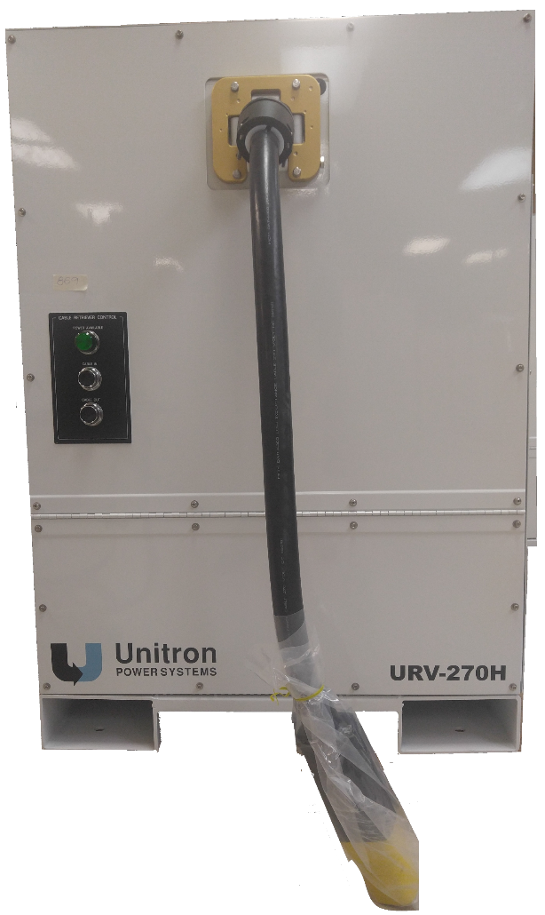
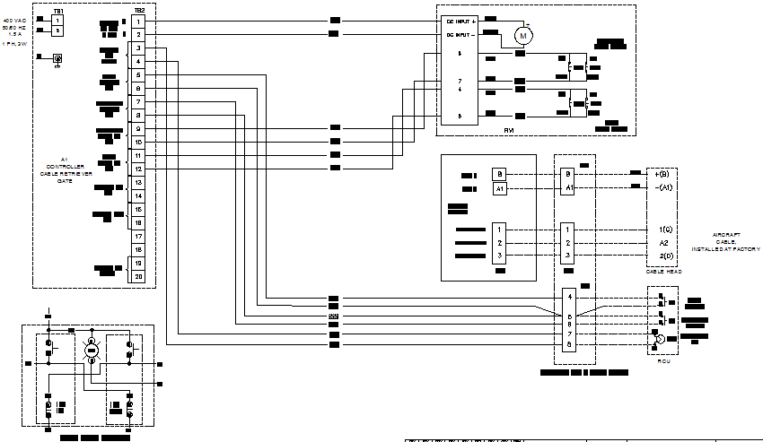
Hands-On Troubleshooting for Cable Reeler
Reeler HOT | Rev 1.00 | Date: 2/12/2017 | © 2016 Unitron LP. All rights reserved.

Slide 2
Class Agenda
The remainder of this training class is broken up into the
following sections:
  Elementary Diagram walkthrough
  Troubleshooting techniques
    Checks without power
    Checks with power
  Demo unit teardown
    Component identification
    Checks without power
    Checks with power
  Sabotage exercise

Slide 3
Elementary Diagram
Component Identification
Component Function

Slide 4
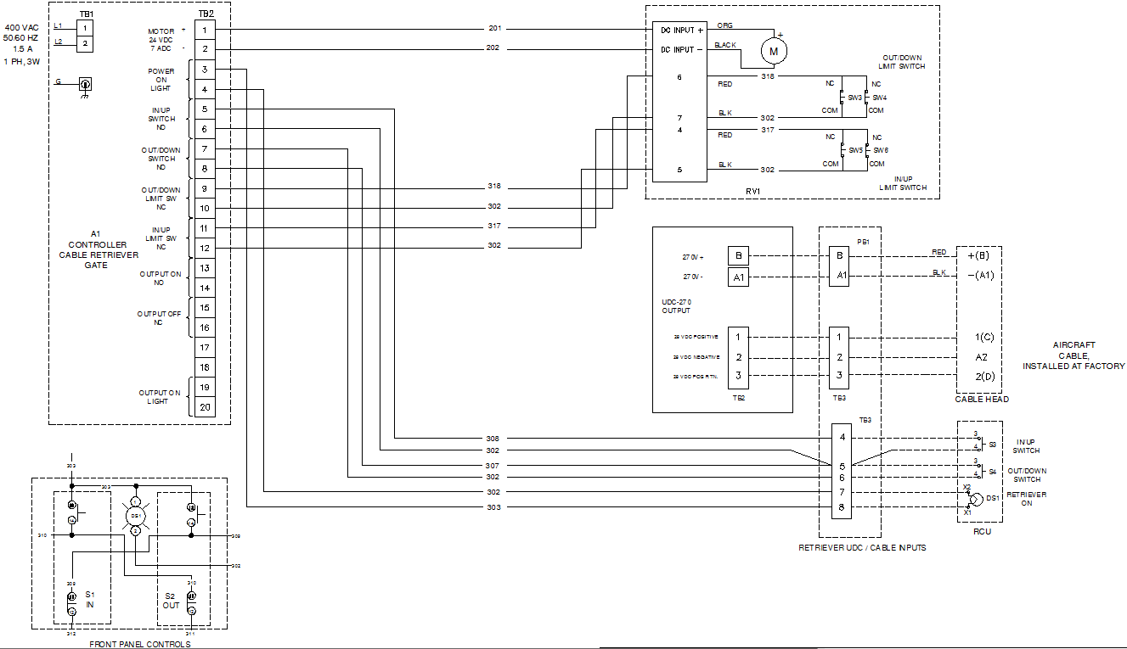
Input Power & Motor

Slide 5
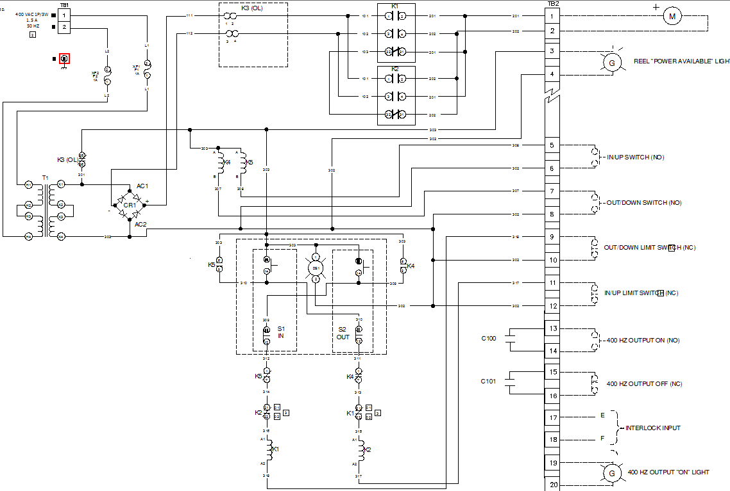
Control

Slide 6
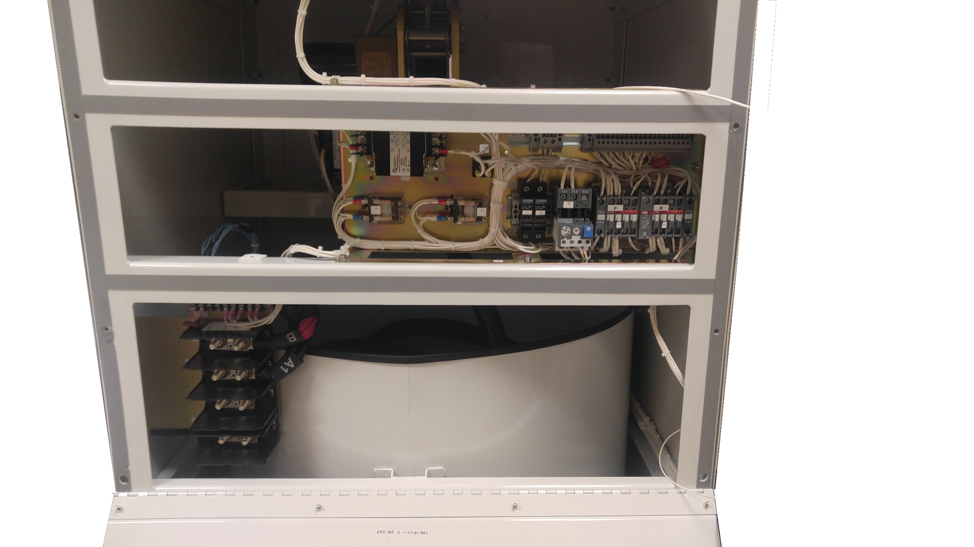
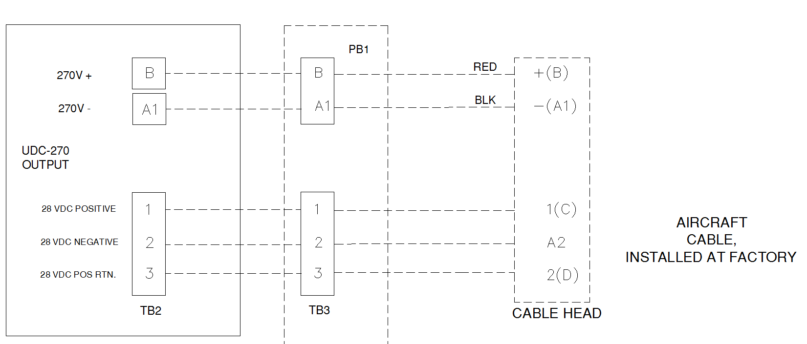
Main Cable Connections
28VDC E&F CONNECTIONS
INPUT POWER
FROM 270VDC
CONVERTER

Slide 7
Input Control Power
Notes:
400VAC from a separate source. 1.5A Capacity

Slide 8
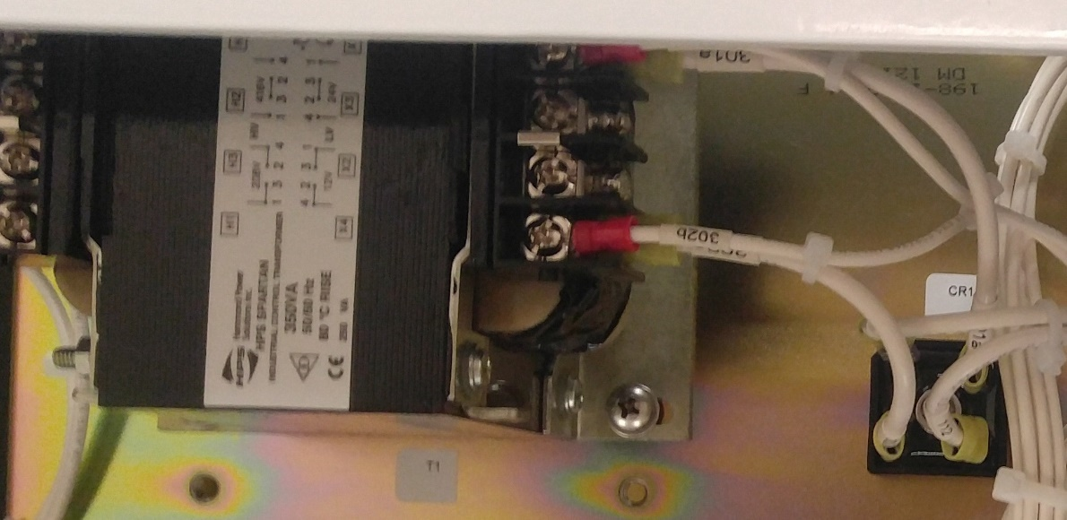
Control Transformer & Diode Bridge
Notes:
T1 steps voltage down from 400 to 24vac, full wave bridge rectifier converts it to DC

Slide 9
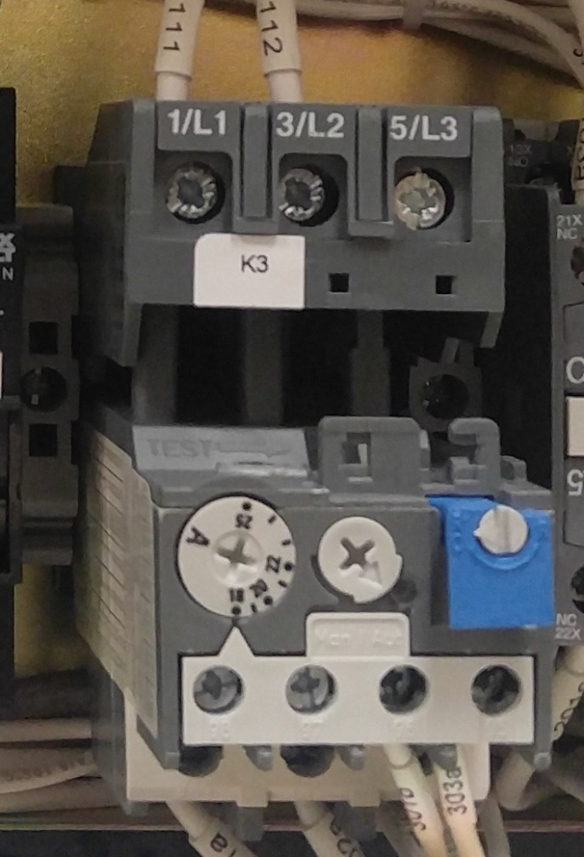
Motor Overload
Notes:
Thermal Overload trips if the current exceeds 18Amps.

Slide 10
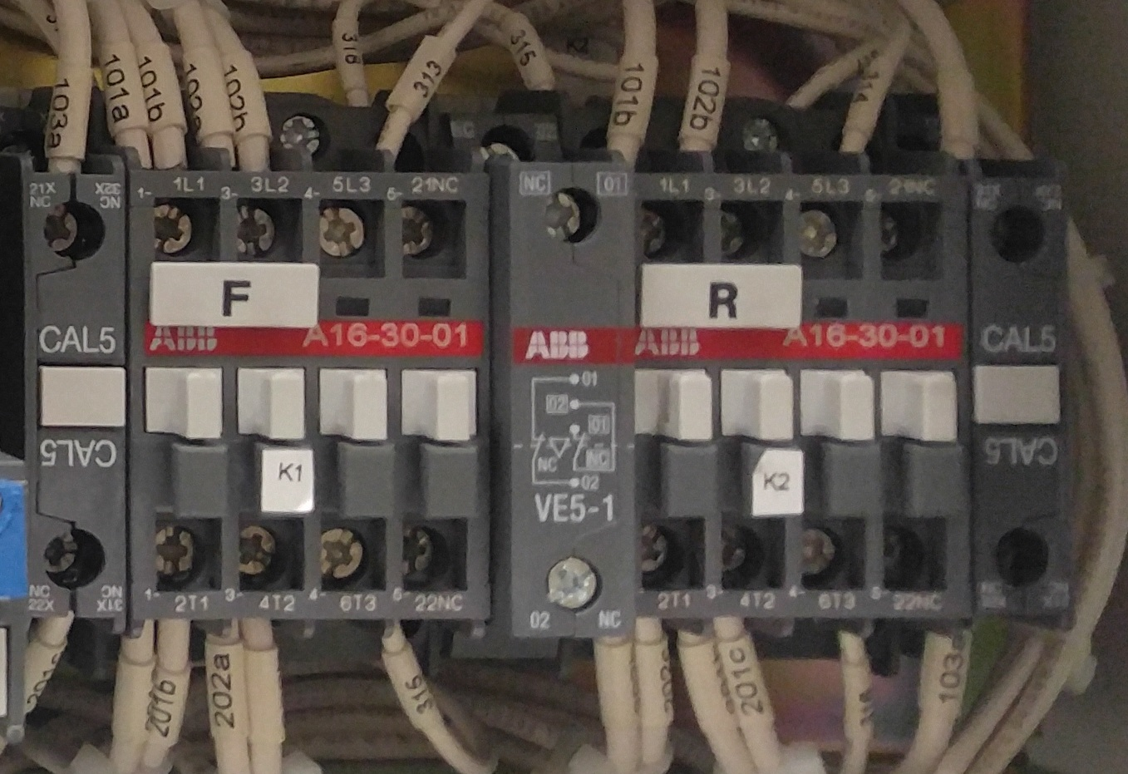
Forward & Reverse Contactors
Notes:
K1 is the forward contactor (cable out), K2 is the reverse (cable in). The contactors simply revers the polarity of the wires to the motor..

Slide 11
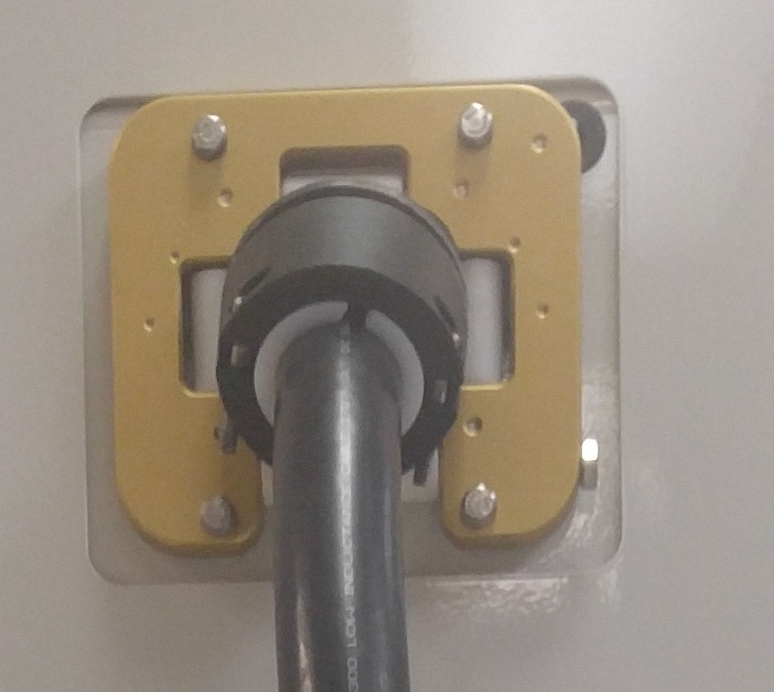
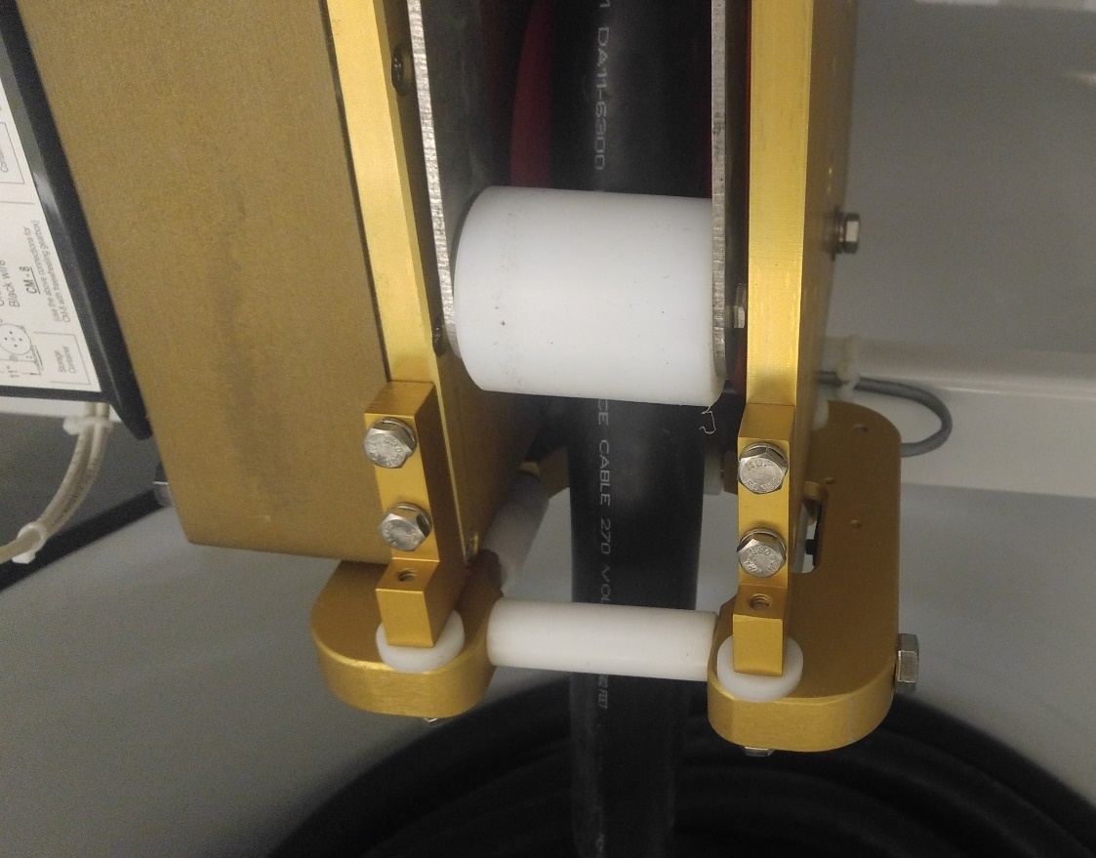
Limit Switches for Motor
In Limit Switch
Out Limit Switch
Safety Collar on each end of the cable
Notes:
Rollers contain the limit switches activated by the collar clamped around the cable

Slide 12
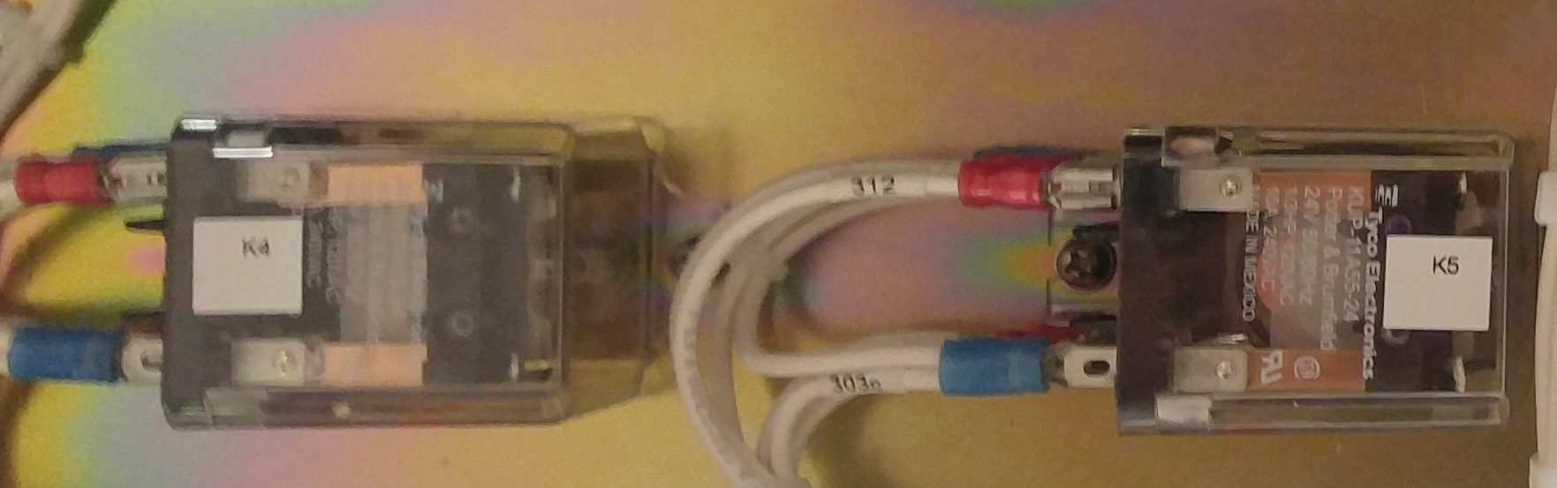
Contactor Slave Relays
Notes:
Slave relays lower the current passing through the push buttons allowing for long wire runs to remote push buttons.
Relays have interlock contacts to ensure main contactors cannot both be closed.

Slide 13
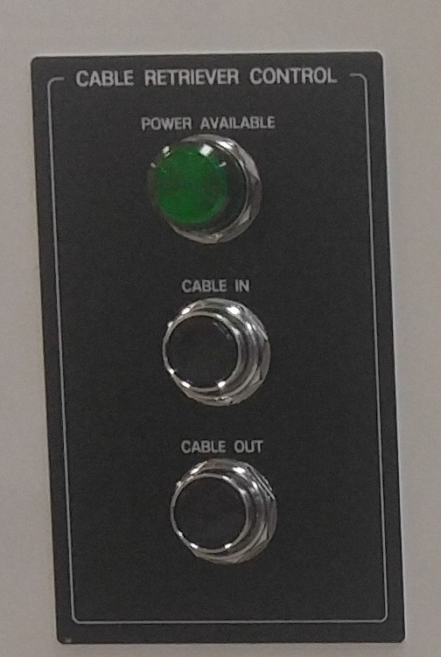
Local Control Buttons & Lights

Slide 14
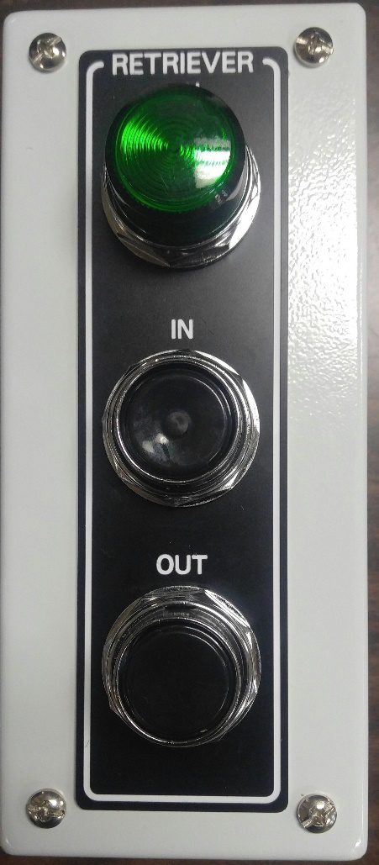
Remote Control Buttons & Lights

Slide 15
Model Numbers
Model Number only describes the type and if Mobile or Fixed
Part Number has detailed information on the options included. Due to the complexity and large number of options, they are not coded into the number.
Contact the factory for a breakdown of a particular part number.
Features include:
Input Voltage Range
Gate Mount
Trailer Mount
URV-270H
198-19073-1

Slide 16
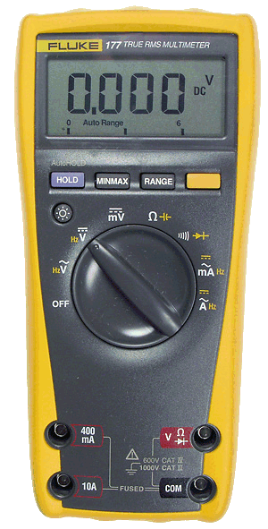
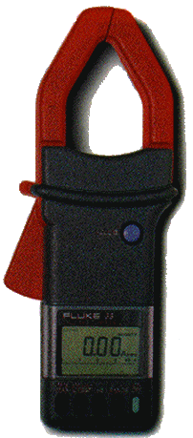
Test Equipment
True RMS
Clamp-on Meter
Digital Multimeter

Slide 17


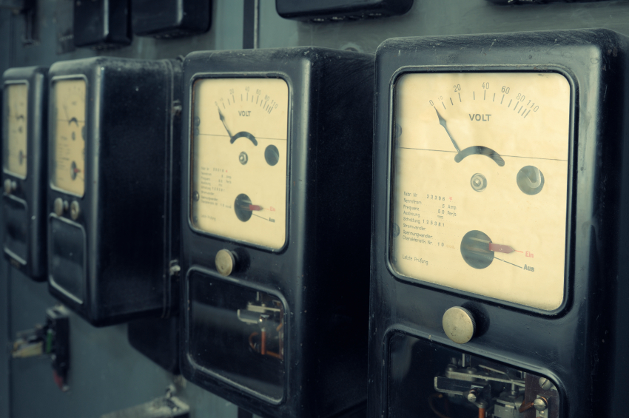
Checks without power

Slide 18
Test Procedure Checklist
Check the following without power applied
Input Transformer
Input Diode Bridge
Input Contactor
Limit Switches
Overload Relay
All Fuses

Slide 19

Warning
WARNING
LETHAL VOLTAGES ARE PRESENT!
Before attempting any checks without power in this troubleshooting manual, make sure that the AC power is disconnected, locked out, and tagged out. Make sure that the converter power source is also locked out and tagged out.
Checking for power
Test Equipment - AC voltmeter set to the highest scale
This test is a mandatory safety check! Before touching any components inside the machine, perform the following test. Check the AC Control voltage terminals TB1-1 and TB1-2, ensure the AC voltage is 0.
Test Equipment - DC voltmeter set to the highest scale
Test the power terminals between 270vdc terminals B & A1. Ensure the voltage is 0.

Slide 20

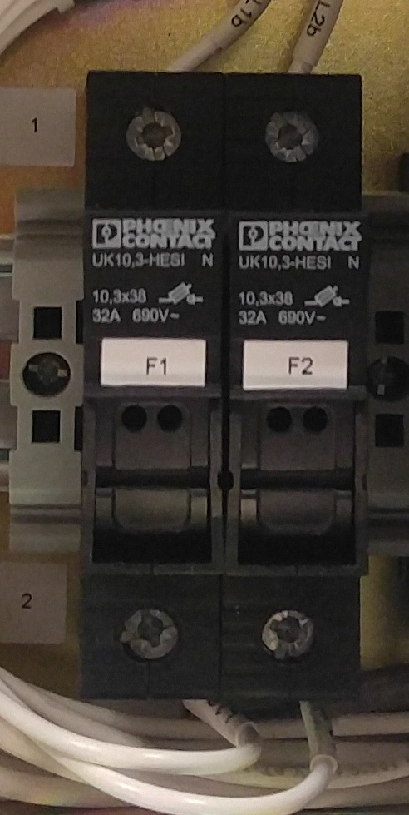
Input Fuses
The control fuses are to protect against an over load or short circuit in the controls
.Pull down on the top of the fuse holder to expose the fuses.
Remove the fuses with fingers or pliers
Test for continuity with a multi-meter
If a fuse is open, test other items in the circuit to determine the cause.

Slide 21
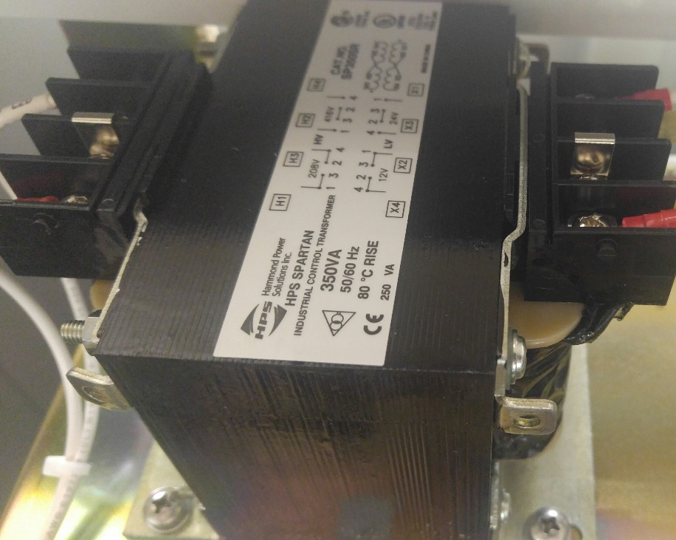
Control Transformer
What is it?
Control Transformer.
What is its purpose?
Convert the high voltage input to
low voltage for use in the controls.
400/24v)
How do I check it?
Multimeter set to resistance, check for shorts
between terminals and ground.

Slide 22
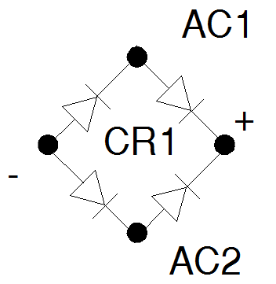
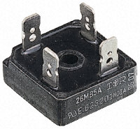
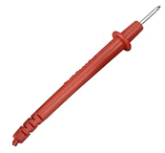
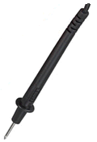
Diode Bridge
The 1-phase rectifier bridge can be
checked with most of today’s digital multimeters set to “diode check” mode
“Diode check” works by forcing a small current through the diode and
measuring the voltage dropped between the two test leads
Check each diode in both the forward and reverse biased direction
One direction will give the voltage drop associated with passing current,
and the other direction will show “OL” for overload
0L
0.5v
Cathode (-)
+
+
-
-
Anode (+)

Slide 23
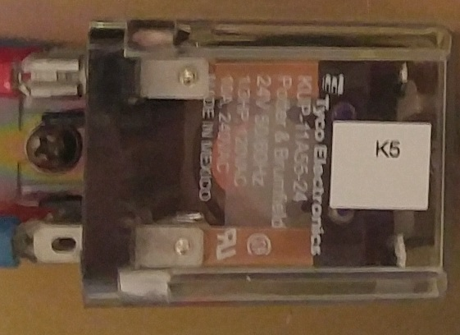
Control Relay
What is it?
Control Relay.
What is its purpose?
Switch a lower power signal to a higher power signal, used in logic circuits to interlock signals.
How do I check it?
Visual check for arcing on contacts, Multimeter set to resistance, check for continuity on coil and normally closed contacts, open on normally open circuits.

Slide 24
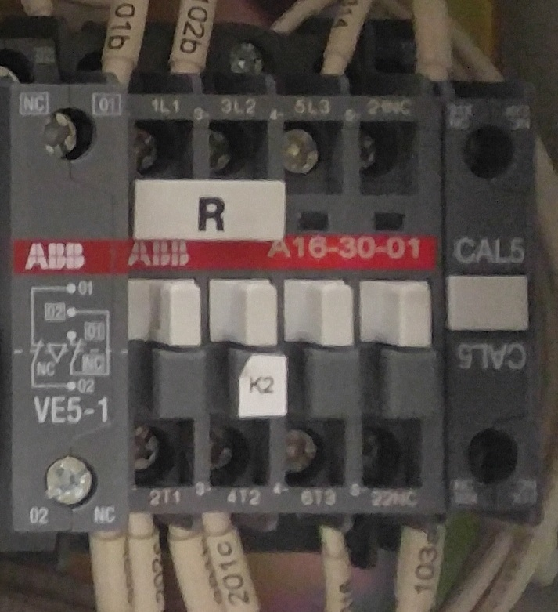
Contactor
What is it?
Contactor.
What is its purpose?
Switch power to a motor or other circuit.
How do I check it?
Visual check for arcing on contacts, Multimeter set to resistance, check for continuity on coil and normally closed contacts, open on normally open circuits.

Slide 25

Overload Relay
What is it?
Overload Relay.
What is its purpose?
Protect motor from excessive current. Thermal bi-metallic strip that opens a contact when it heats up.
How do I check it?
Multimeter set to resistance, check for continuity on normally closed contacts, and continuity on main power circuit.

Slide 26
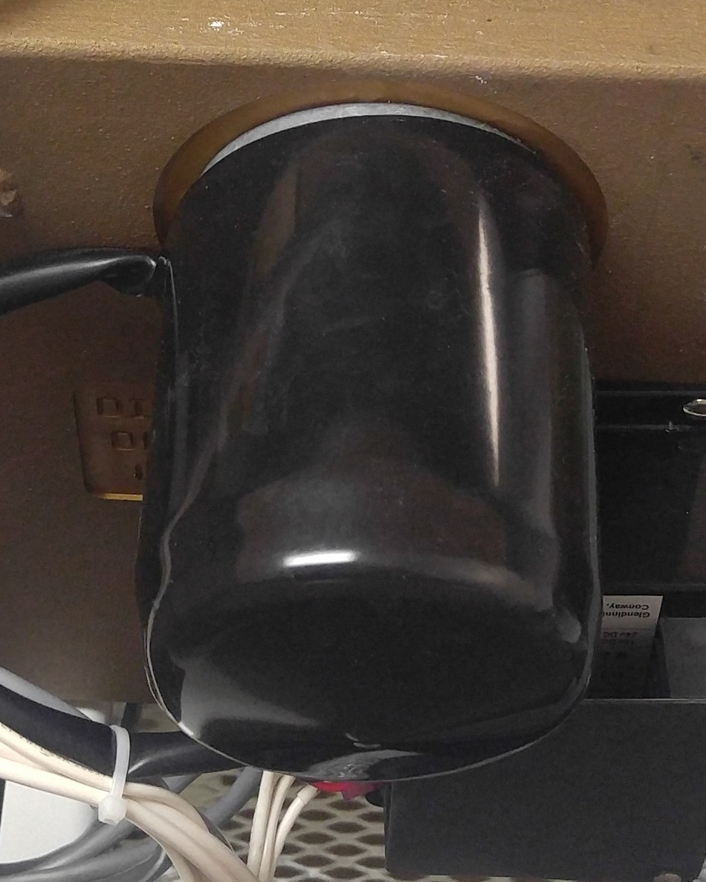
Motor
What is it?
24vdc Motor.
What is its purpose?
Operate the rollers to push the cable out or reel it into the bin.
How do I check it?
Check for continuity in the windings of the motor (Orange & Black Wires). Check for free movement of the motor shaft.

Slide 27
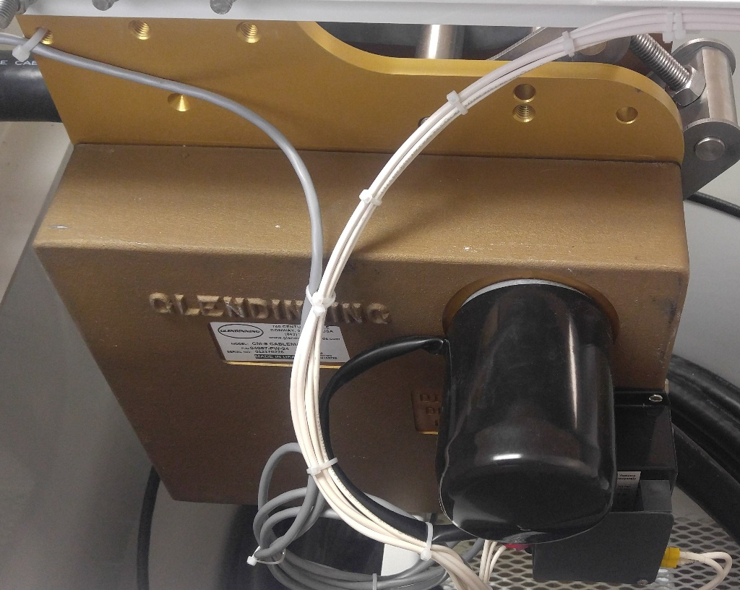
Gear Box
What is it?
Gear Box.
What is its purpose?
Reduce the speed of the motor to operate the rollers at a safe rpm.
How do I check it?
Check for loose bolts and nuts and signs of overheating on outside casing.
Check for signs of mechanical damage to casing or rollers.

Slide 28

Checks with power

Slide 29
Warning
WARNING
LETHAL VOLTAGES ARE PRESENT!
Extreme caution must be used when working on the Reeler. Make sure all power is removed prior to touching any circuits.

Slide 30
Warning
WARNING
LETHAL VOLTAGES ARE PRESENT!
General relationship for a 60-cycle, hand-to-foot shock of one second's duration.
From www.osha.gov

Slide 31
Warning
WARNING
LETHAL VOLTAGES ARE PRESENT!
High voltage electrical energy greatly reduces the body's resistance by quickly breaking down human skin. Once the skin is punctured, the lowered resistance results in massive current flow.
Ohm's law is used to demonstrate the action. At 1,000 volts, Current = Volts/Ohms = 1,000/500 = 2 Amps which can cause cardiac standstill and serious damage to internal organs.
When muscular contraction caused by stimulation does not allow the victim to free himself from the circuit, even relatively low voltages can be extremely dangerous, because the degree of injury increases with the length of time the body is in the circuit.
LOW VOLTAGE DOES NOT IMPLY LOW HAZARD!
100mA for 3 seconds = 900mA for .03 seconds
in causing fibrillation
Wet conditions are common during low-voltage electrocutions. Under dry conditions, human skin is very resistant. Wet skin dramatically drops the body's resistance.
Dry Conditions: Current = Volts/Ohms = 120/100,000 = 1mA
a barely perceptible level of current
Wet conditions: Current = Volts/Ohms = 120/1,000 = 120mA
sufficient current to cause ventricular fibrillation

Slide 32
Warning
WARNING
LETHAL VOLTAGES ARE PRESENT!
High voltage electrical energy greatly reduces the body's resistance by quickly breaking down human skin. Once the skin is punctured, the lowered resistance results in massive current flow.
Ohm's law is used to demonstrate the action. At 1,000 volts, Current = Volts/Ohms = 1,000/500 = 2 Amps which can cause cardiac standstill and serious damage to internal organs.
Note that a difference of barely more than 100 milliamperes exists between a current that is barely perceptible and one that can kill!
When muscular contraction caused by stimulation does not allow the victim to free himself from the circuit, even relatively low voltages can be extremely dangerous, because the degree of injury increases with the length of time the body is in the circuit.
LOW VOLTAGE DOES NOT IMPLY LOW HAZARD!
100mA for 3 seconds = 900mA for .03 seconds
in causing fibrillation
Wet conditions are common during low-voltage electrocutions. Under dry conditions, human skin is very resistant. Wet skin dramatically drops the body's resistance.
Dry Conditions: Current = Volts/Ohms = 120/100,000 = 1mA
a barely perceptible level of current
Wet conditions: Current = Volts/Ohms = 120/1,000 = 120mA
sufficient current to cause ventricular fibrillation

Slide 33
Test Procedure Checklist
Complete the following after proper safety precautions have been taken
Apply Input Power to the Reeler
Check Line Voltage
Check 24V Power Supply
Check Movement of cable when buttons pressed.

Slide 34
Apply Power
If the Reeler fails to operate at all, or only operates in one direction, the most likely cause of the problem is that some part of the electrical system has failed. The following guide will help you to troubleshoot and repair the Reeler motor and control circuits.
In general, the problem will fall into one of two categories, either the Reeler does not operate in either direction or the unit only operates in one direction (IN or OUT).

Slide 35
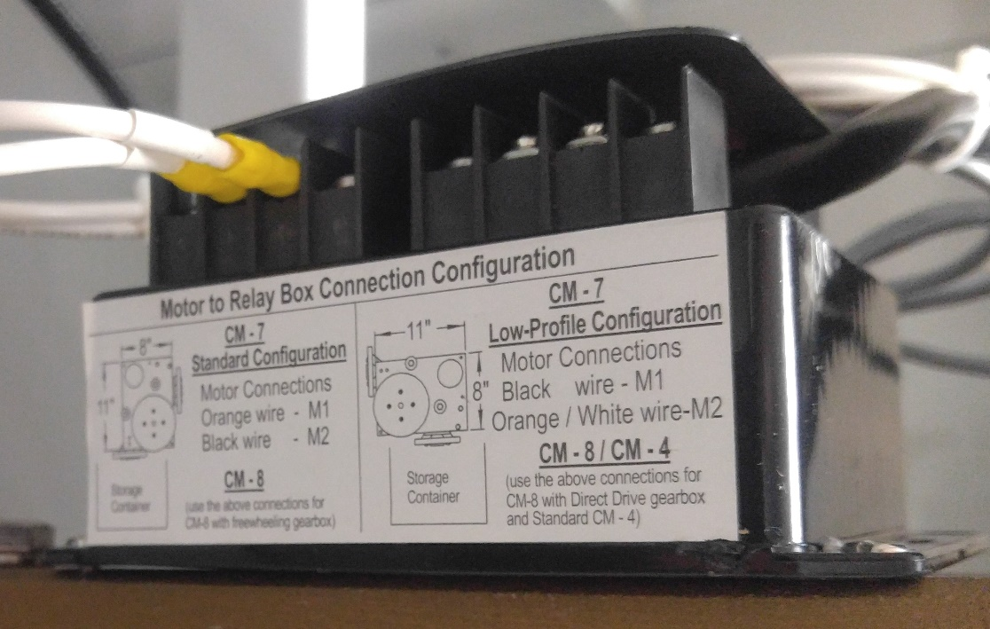
Reeler doesn’t operate in either direction
1. Check the Supply Voltage at the Relay Box.
  CHECK CORRECT VOLTAGE — On the relay box, measure the voltage between input power terminals. The power supply to the unit should be connected via a fuse or circuit breaker (Fuse rating: 24 VDC: 15 amps). If no voltage is observed at the relay box, check for a tripped breaker, blown fuse or other electrical supply problem.
CHECK VOLTAGE POLARITY — Verify that power is supplied to the unit with the correct polarity.

Slide 36
Reeler doesn’t operate in either direction
2. Check the operation of the motor
  Remove the motor leads from terminal connectors on the relay box. Connect the power directly to the motor leads (polarity is not important). The motor should operate in one direction; reversing the power / motor lead connection will reverse the motor direction.
If the motor fails to operate at this point, motor replacement is required
IMPORTANT Motor leads MUST be disconnected from relay terminal connections in order to test motor operation. Failure to remove the motor leads from the relay box before applying power to the motor leads will cause damage to the relay box components.

Slide 37
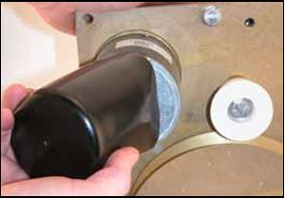
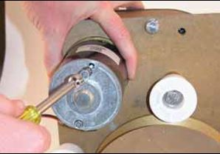
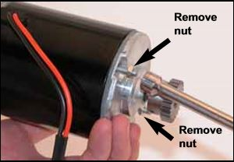
Reeler doesn’t operate in either direction
Motor Replacement
Remove rubber motor cover from old motor, keep this for installation on the new motor.
Using a 5/16” hex socket wrench, remove the (2) 10/32 motor mounting bolts and remove the Reeler motor from the unit.
Remove the (2) 10/32 nuts from the new replacement motor. DO NOT REMOVE the motor mounting bolts from the new motor. (NOTE: The nuts on the new / replacement motor are used to hold the motor together during shipping. Make sure that you hold the motor end plates to keep them from separating from the motor body.)

Slide 38
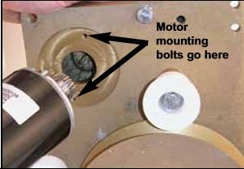
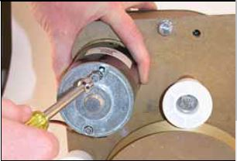
Reeler doesn’t operate in either direction
Motor Replacement (cont.)
Insert the new replacement motor into the hole in the Reeler chassis, making sure to line-up the (2) 10/32 motor mounting bolts with the tapped holes in the chassis..
Using a 5/16” hex socket wrench, tighten the (2) 10/32 motor mounting bolts evenly, making sure that they are equally tight. Replace the black rubber motor cover removed from Step 1 on the new replacement motor. Test Reeler unit operation

Slide 39
Reeler doesn’t operate in either direction
3. Control circuit failure (In-limit, Out-limit, Power Switch, Relay Box
  If the motor operates when it is connected directly to power, but the Reeler does not operate in either direction when the normal power switch is moved, some part of the Reeler motor control circuit has most likely failed. This would include the Reeler relay, In / Off / Out control switch, or limit switches.
Complete the troubleshooting steps listed under the next section: "The Cablemaster only operates in one direction (either IN or OUT)"

Slide 40
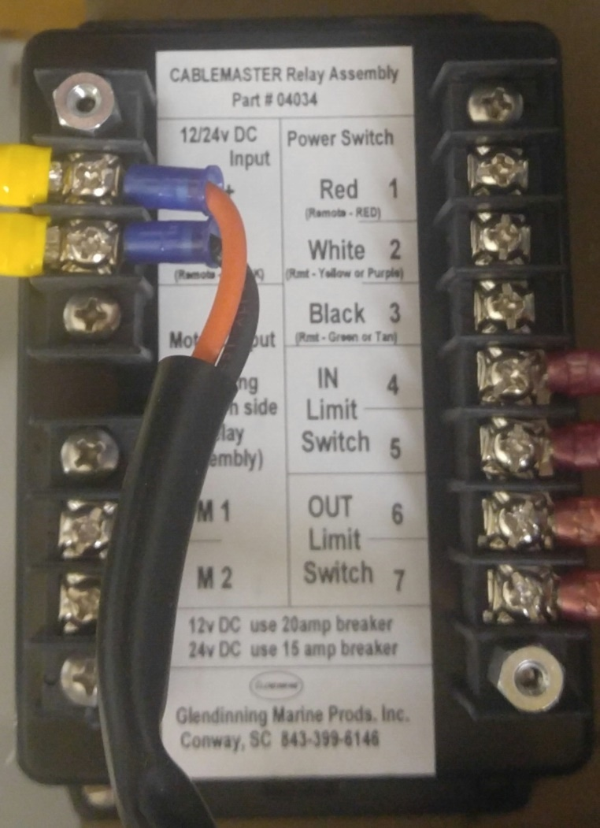
Reeler only operates in one direction either In or Out
1. Check the appropriate Limit Switch
  a. The in- and out-limit switches are "normally closed"; that is, they conduct electrical current until they are actuated. If one of the limit switches fails, it will not allow the cable to operate in the direction that of the failed switch.
b. The limit switches can be checked by installing jumpers at the appropriate terminals on the relay box. If installing a jumper corrects the problem, replace the appropriate switch.
IN
OUT

Slide 41

Reeler only operates in one direction either In or Out
2. Check the power switch for proper operation
The power switch can be checked by installing wire jumpers in certain relay terminals in order to simulate the power switch operation. Follow the directions on the photos to install the wire jumper(s) in the appropriate terminals If the Reeler now operates in both directions, replace the power switch
1) Connect one end of a jumper on Relay Box terminal
#1.
2) Briefly touch the other end of the second jumper to
Terminal #2 or Terminal #3.
When Terminal #2 or Terminal #3 are contacted by
the second jumper, the Cablemaster should operate
in one direction or the other. If the Cablemaster now
operates in both directions, replace the power switch.

Slide 42
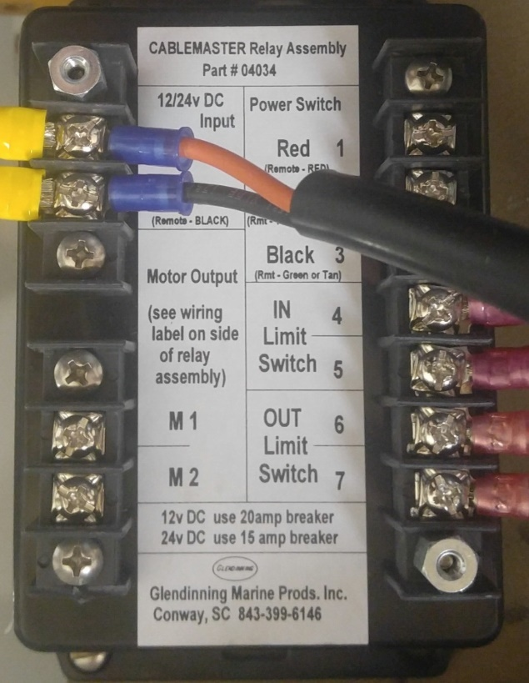
Reeler only operates in one direction either In or Out
3. Replace relay box
  If the Reeler still does not operate in both directions, the Relay Box is faulty.

Slide 43
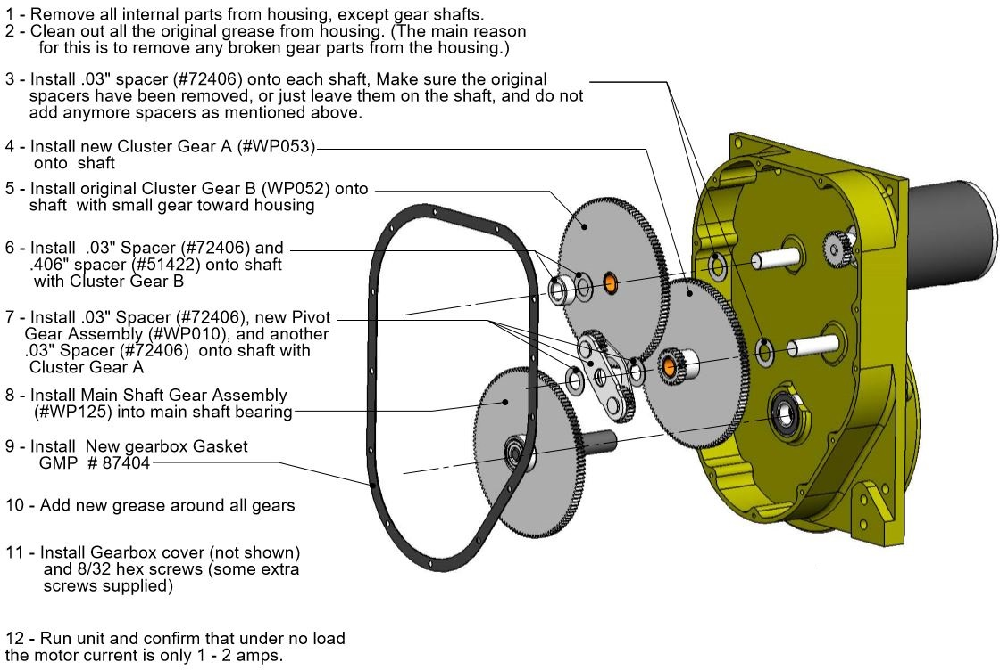
Gear Replacement Guide

